Slide 1
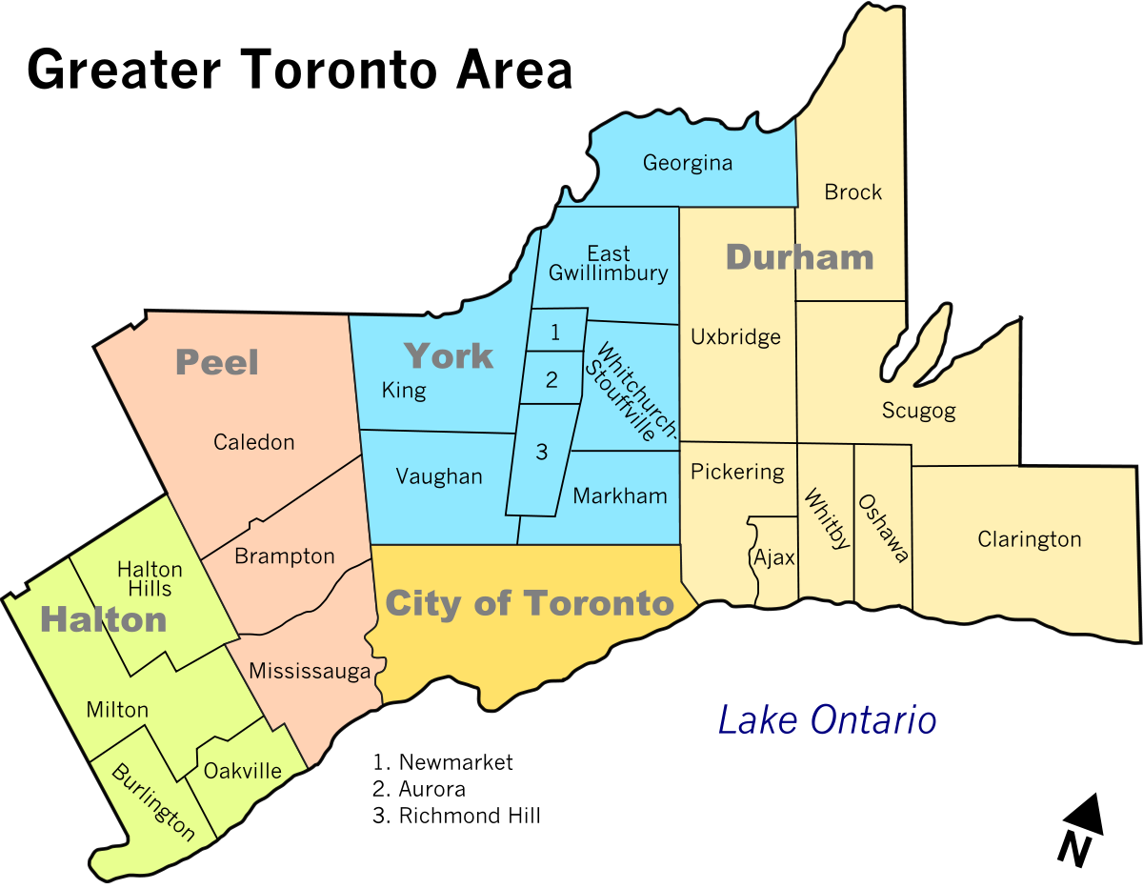
Analysis of Property Prices in Toronto Greater Area, Canada

Slide 2
Project overview
In this project, the house prices listed in the various regions of Greater Toronto Area (GTA) on the website www.realtor.ca are analyzed.
The prices were scraped from the website on March 16, 2022.
The data was cleaned bringing it into a suitable format facilitating the data analysis.
Exploratory data analysis was performed on the scraped data set.
Classification and regression machine learning models were develop to predict the property prices.
Skills demonstrated:
Web-scraping (using Selenium package available with Python programming language.
Data cleaning (using regex and pandas package in Python).
Exploratory data analysis (pandas, numpy, seaborn and matplotlib packages in Python).
Classification and regression model development and their hyper-parameter tuning using scikit-learn package in Python.
Complete code for the project can be found in the Github repository at: Mangaljit/Toronto_Property_Prices_Analysis (github.com)
A similar project analyzing the property prices in the city of Montreal, Canada was also developed.
The details can be found at Mangaljit/Montreal_Property_Prices_Analysis (github.com)

Slide 3
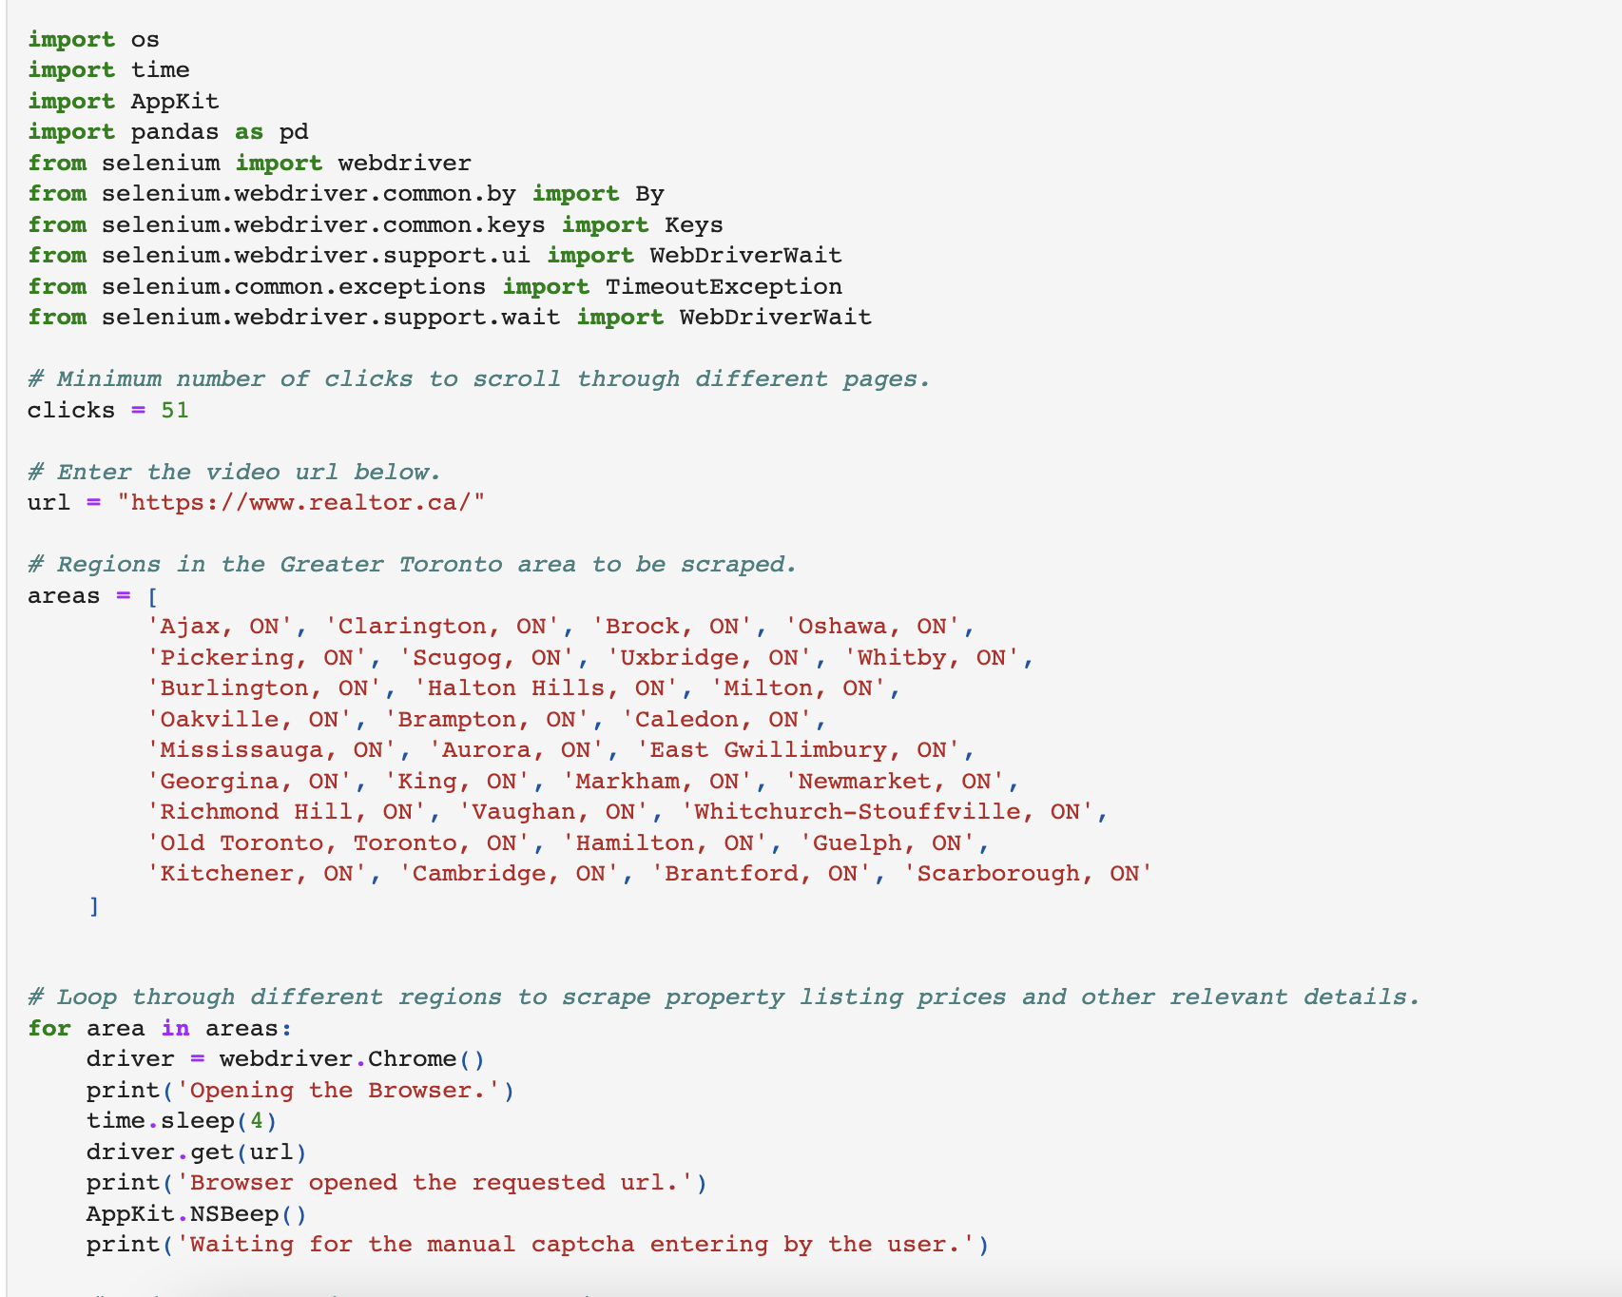
Web scraping
A snapshot of the python code for the web scraping is shown below.
Complete code can be found in the GitHub repository at: Mangaljit/Toronto_Property_Prices_Analysis (github.com)

Slide 4
A quick look at the dataset
price | region | address | bedrooms | bathrooms | pricem
799000 | Ajax, ON | 2 ROLLO DR, Ajax, Ontario | 3 | 3 | 0.799
989000 | Ajax, ON | 717 OLD HARWOOD AVE, Ajax, Ontario | 2 | 1 | 0.989
999900 | Ajax, ON | 52 ADDLEY CRES, Ajax, Ontario | 3 | 4 | 0.9999
799900 | Ajax, ON | 249 MONARCH AVE, Ajax, Ontario | 3 | 3 | 0.7999
899999 | Ajax, ON | 18 MONK CRES, Ajax, Ontario | 3 | 3 | 0.899999
... | ... | ... | ... | ... | ...
1899000 | Scarborough, Toronto, ON | #MAIN UN -2977 LAWRENCE AVE E AVE, Toronto, On... | 8 | 4 | 1.899
752880 | Scarborough, Toronto, ON | #406 -3220 SHEPPARD AVE E, Toronto, Ontario | 2 | 2 | 0.75288
1150000 | Scarborough, Toronto, ON | #902 -2799 KINGSTON RD, Toronto, Ontario | 3 | 3 | 1.15
550000 | Scarborough, Toronto, ON | #506 -2201 KINGSTON RD, Toronto, Ontario | 1 | 1 | 0.55
1820000 | Scarborough, Toronto, ON | 103 SLAN AVE, Toronto, Ontario | 7 | 4 | 1.82
The dataset has a total of 7324 rows and 6 columns.

Slide 5
There are 31 regions in the scraped data set.
Region
King
Caledon
Oakville
Richmond Hill
East Gwillimbury
Aurora
Whitchurch-Stouffville
Markham
Vaughan
Halton Hills
Uxbridge
Milton
Newmarket
Brampton
Scugog
Burlington
Whitby
Pickering
Ajax
Mississauga
Georgina
Scarborough Toronto
Clarington
Oshawa
Brock
Guelph
Old Toronto Toronto
Brantford
Hamilton
Cambridge
Kitchener

Slide 6
Median property price in different regions
region | median price in million dollars | no. of listings
King | 2.969 | 56
Caledon | 1.899 | 132
Oakville | 1.79945 | 422
Richmond Hill | 1.6985 | 382
East Gwillimbury | 1.6885 | 92
Aurora | 1.688 | 130
Whitchurch-Stouffville | 1.499 | 98
Markham | 1.39945 | 482
Vaughan | 1.399 | 478
Halton Hills | 1.397 | 80
Uxbridge | 1.314 | 18
Milton | 1.2999 | 215
Newmarket | 1.299 | 139
Brampton | 1.199 | 597
Scugog | 1.1749 | 16
Burlington | 1.1499 | 306
Whitby | 1.099 | 130
Pickering | 0.99995 | 84
Ajax | 0.999 | 114
Mississauga | 0.999 | 579
Georgina | 0.999 | 118
Scarborough Toronto | 0.988 | 414
Clarington | 0.899999 | 127
Oshawa | 0.899 | 234
Brock | 0.899 | 26
Guelph | 0.898988 | 186
Old Toronto Toronto | 0.839 | 444
Brantford | 0.799999 | 131
Hamilton | 0.7999 | 579
Cambridge | 0.7999 | 163
Kitchener | 0.7499 | 297

Slide 7
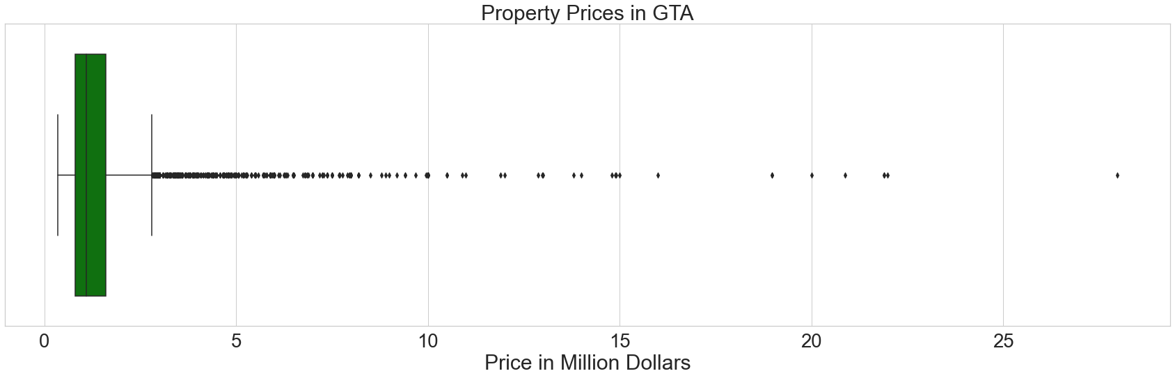
Spread of property prices in GTA

Slide 8
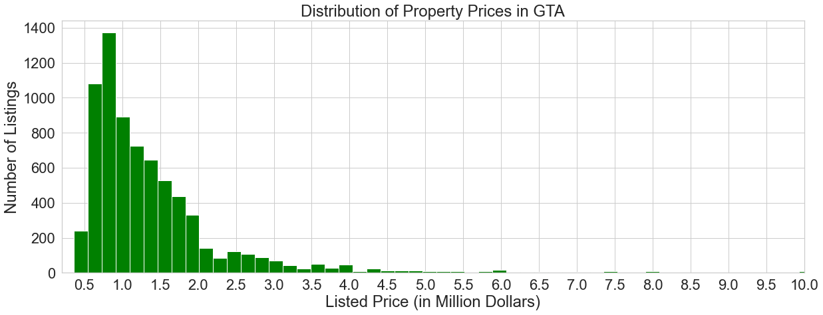
Distribution of Property prices in GTA
Above figure shows that majority of the property prices in GTA lie in a range between 0.5-2.0 million dollars.

Slide 9
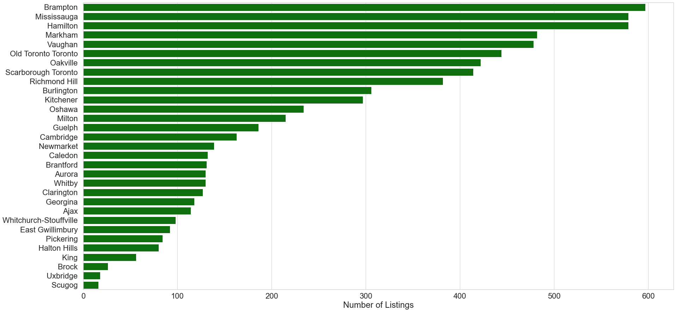
Number of listings in different regions
Brampton , Mississauga , Hamilton , Markham and Vaughan are regions with one of the highest number of listings.

Slide 10
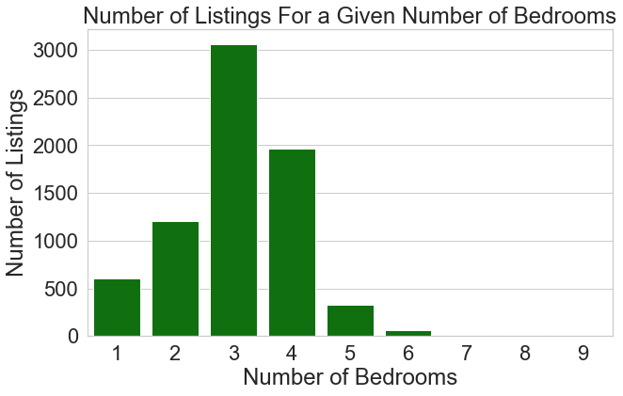
Number of property listings with a given number of bedrooms

Slide 11
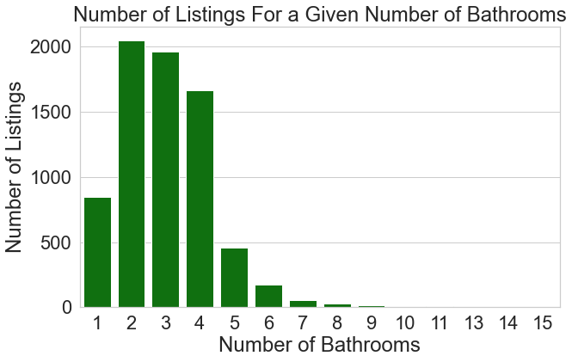
Number of property listings with a given number of bathrooms

Slide 12
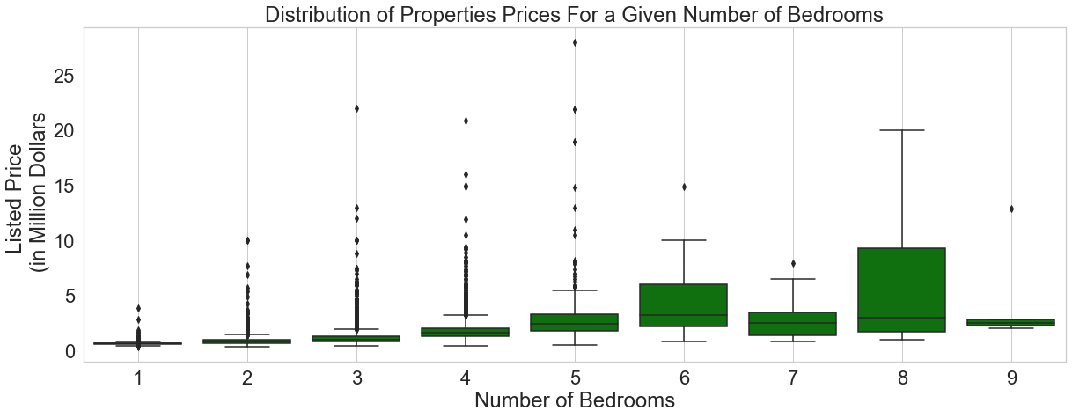
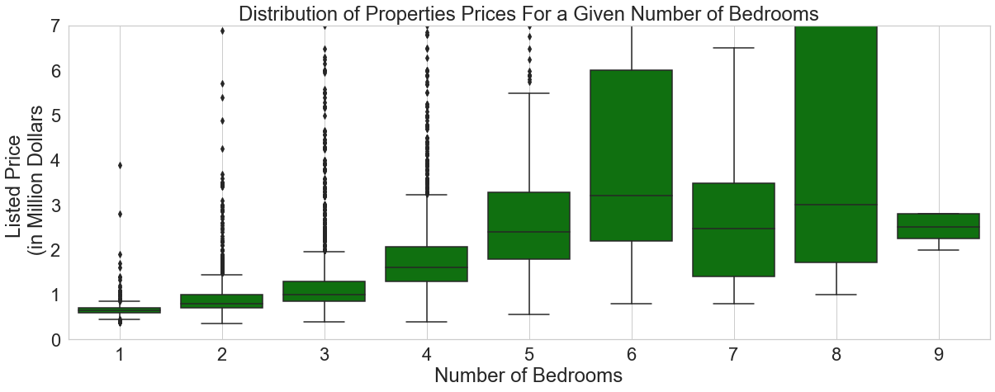
Distribution of property prices for a given number of bedrooms
The median price, indicated by the horizontal line in the box increases with the increase in the number of bedrooms a property contains.

Slide 13
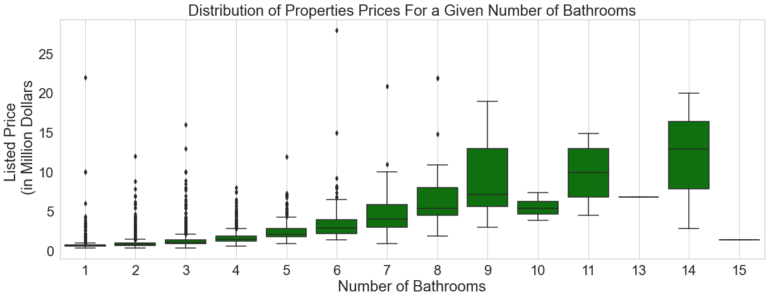
Distribution of property prices for a given number of bathrooms
The median price also increases with the increase in the number of bathrooms a property contains.

Slide 14
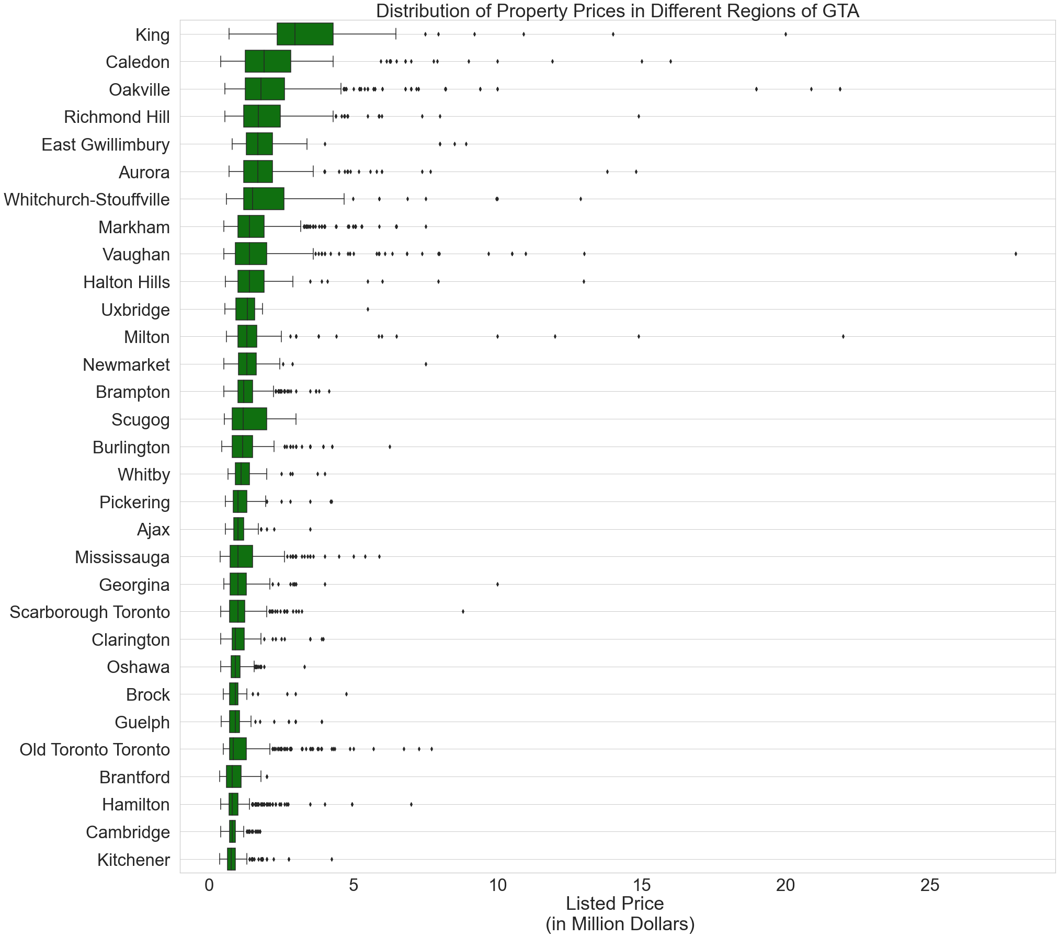
Distribution of property prices in different regions
The exploratory data analysis shows that the number of bedrooms and number of bathrooms a property contains, as well as the region where a property is located are important factors in determining the listed price of the property.

Slide 15
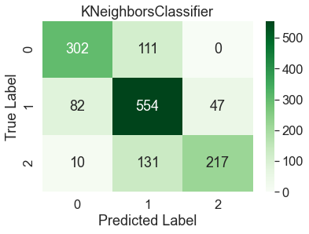
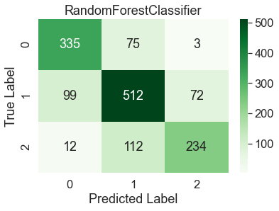
Regression model predicting the property prices in GTA
Both linear as well as the second order polynomial regression models were developed.
Linear regression model delivered a mean absolute accuracy of 0.244 million dollars on the testing data set.
Polynomial regression model delivered a mean absolute accuracy of 0.233 million dollars on the testing data set.
Classification model predicting the property prices in GTA
For the classification model, the entire dataset was categorized into three levels. The first level, assigned with a value of 0 indicates a property price less that 0.8 million dollars. The second level, assigned with a value of 1 will indicates a property price in the range of 0.8-1.6 million dollars. And finally, the third level, assigned with a value of 2 will indicate a property price greater than 1.6 million dollars.
K-nearest neighbors and Random forest model was developed, delivering an overall accuracy of 0.7379 and 0.7434 respectively.
Complete code and the detailed methodologies can be found in the GitHub repository at: Mangaljit/Toronto_Property_Prices_Analysis (github.com)

Slide 16
End of presentation

